Slide 1
Knightly Knockout

Slide 2
TABLE OF CONTENTS
Game Description
Completed prototype demo key points
01
02
What is the game
What points have been completed and how

Slide 3
Game Description
01

Slide 4
Knightly Knockout is a first person 1v1 swordfighting game. The first player to win 3 round wins.
The game will be networked multiplayer.

Slide 5
Completed prorotype features

Slide 6
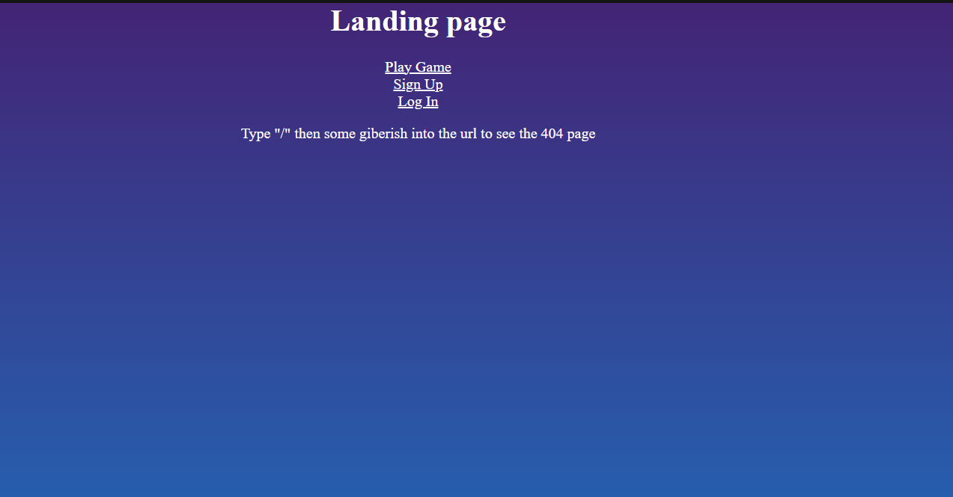
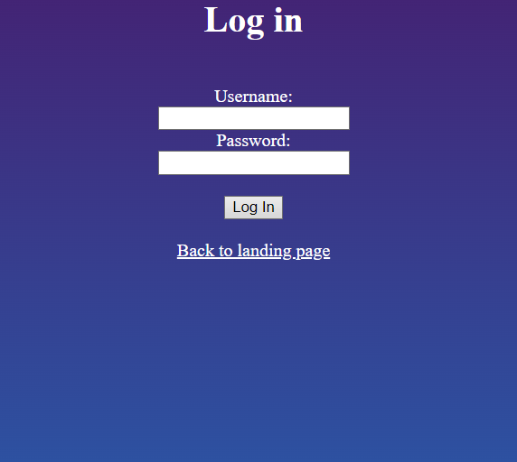
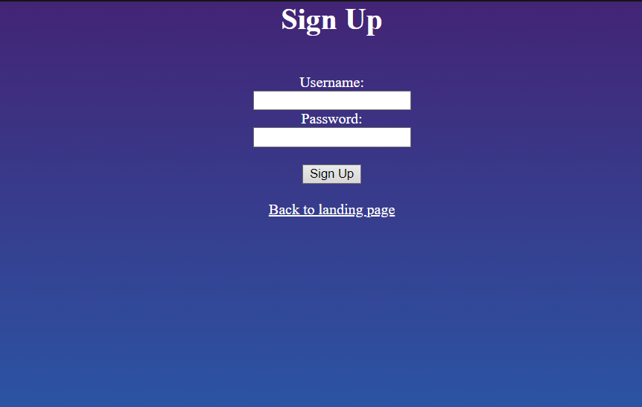
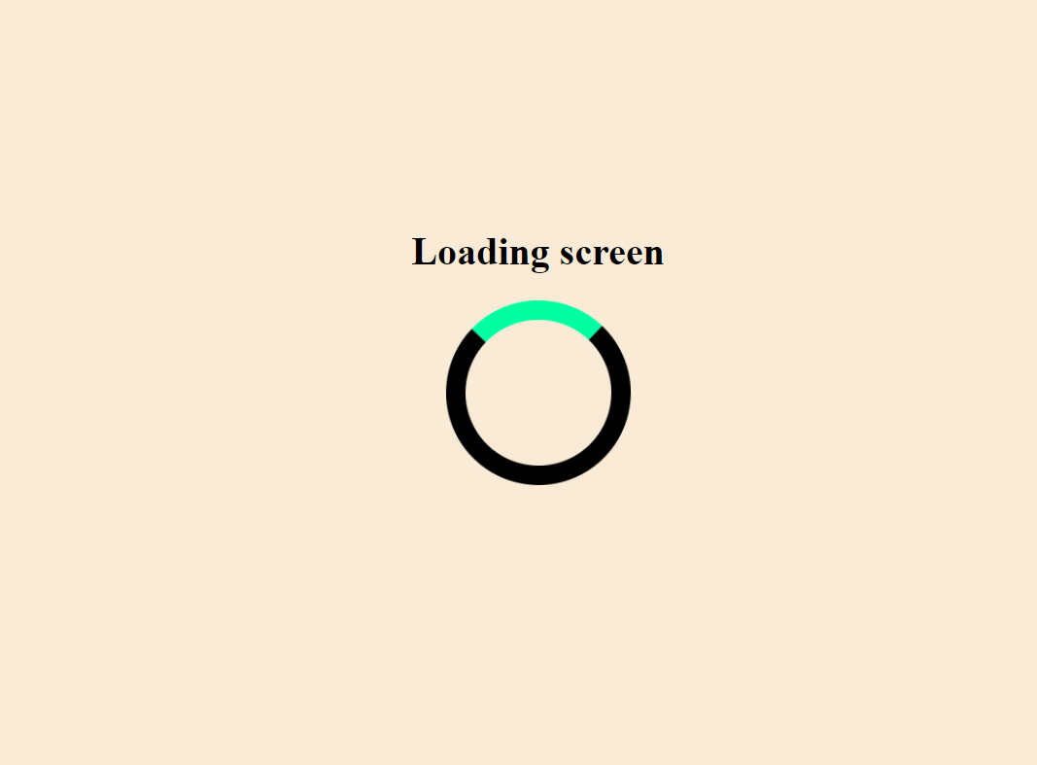

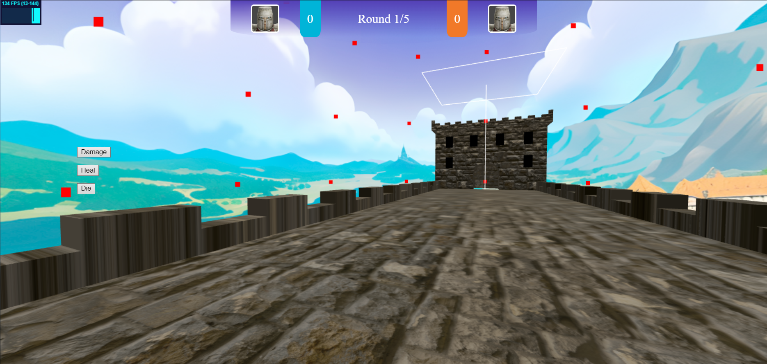
Completed features
Game websites design (client-side only): has Introduction page, Login page, New user register page, 404 page, game loading page and game pages.

Slide 7
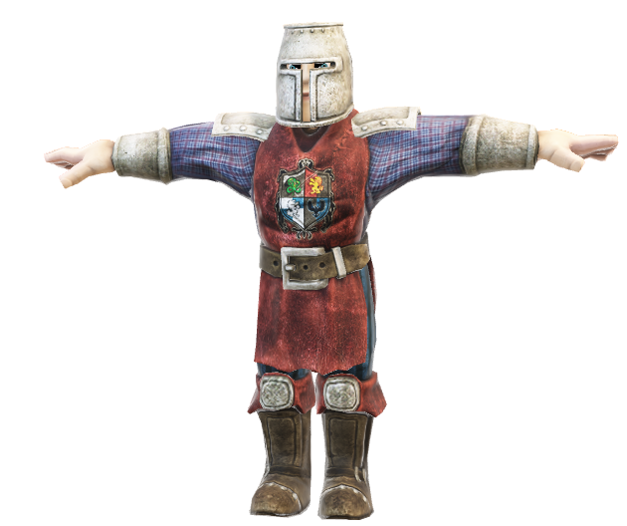
Completed features
Game assets: for example, character, landscape/environment and enemy design (if applicable).
Player/enemy character:
Castle Bridge environment:

Slide 8
RESOURCES
Did you like the resources on this template? Get them for free at our other websites:
PHOTOS:
Low angle stone castle with trees
Low angle old stone castle
VECTORS:
Collection of different knight emblems
Knight emblem design set
Set of colorful knight emblems
Dark knight emblem templates
Set of elegant knight emblems

